Slide 1
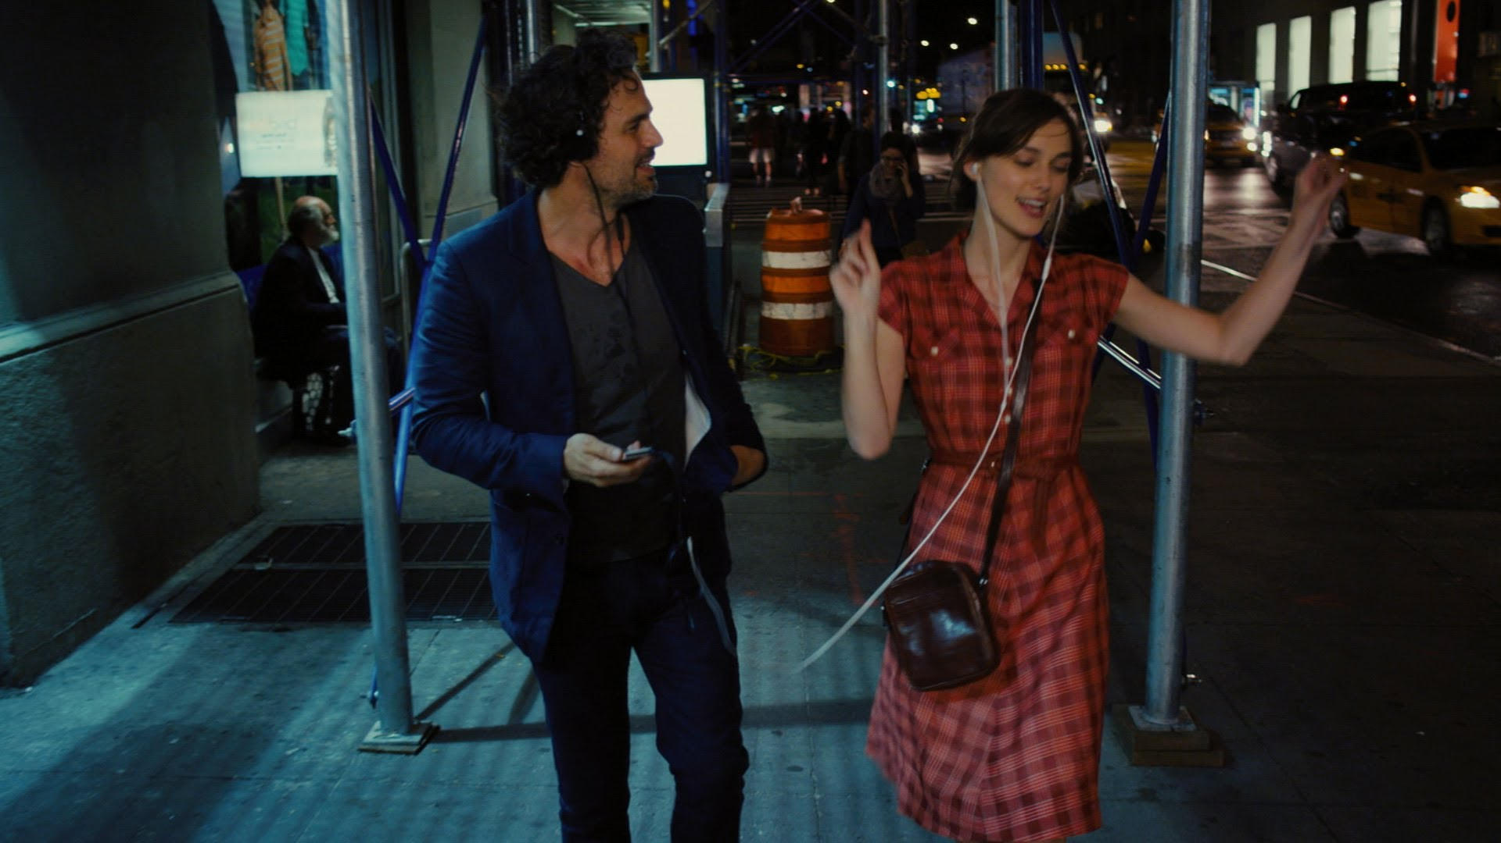
People love music
and
they are fond of sharing music with their friends

Slide 2
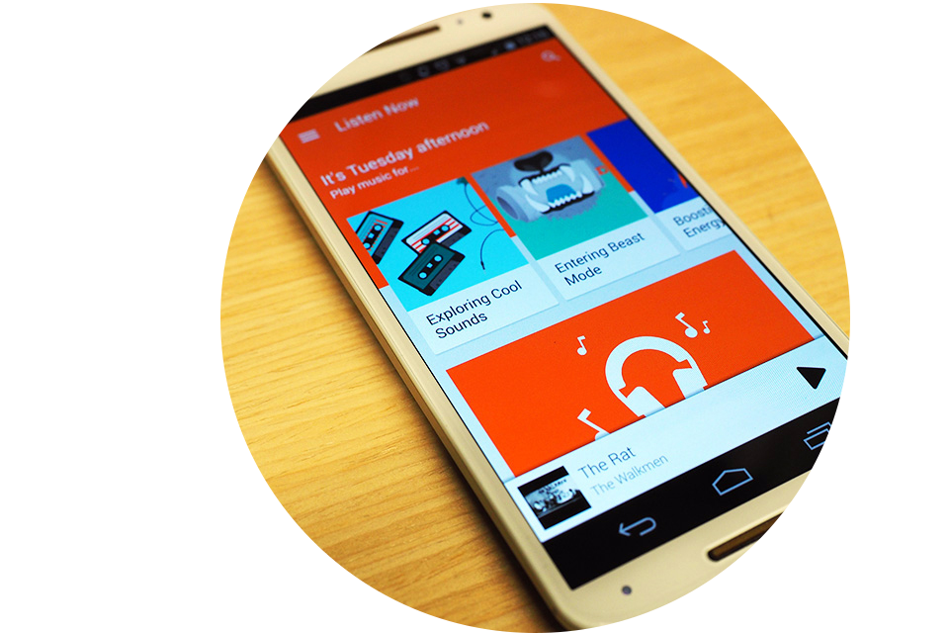
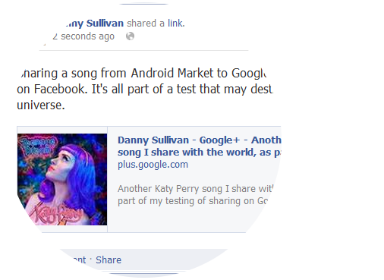
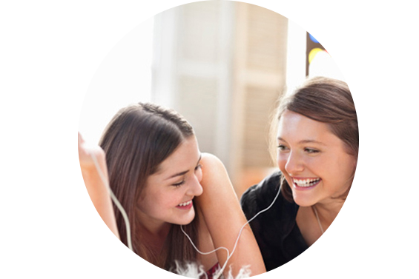
Music is usually shared by several ways.
Music APP
Social Network Sites
Listen to music together
Therefore, I want to use music to connect people’s life.

Slide 3
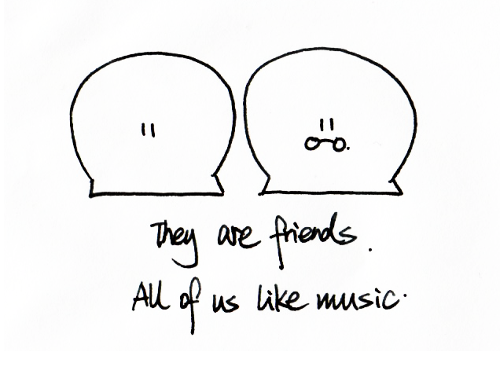
Storyboard

Slide 4
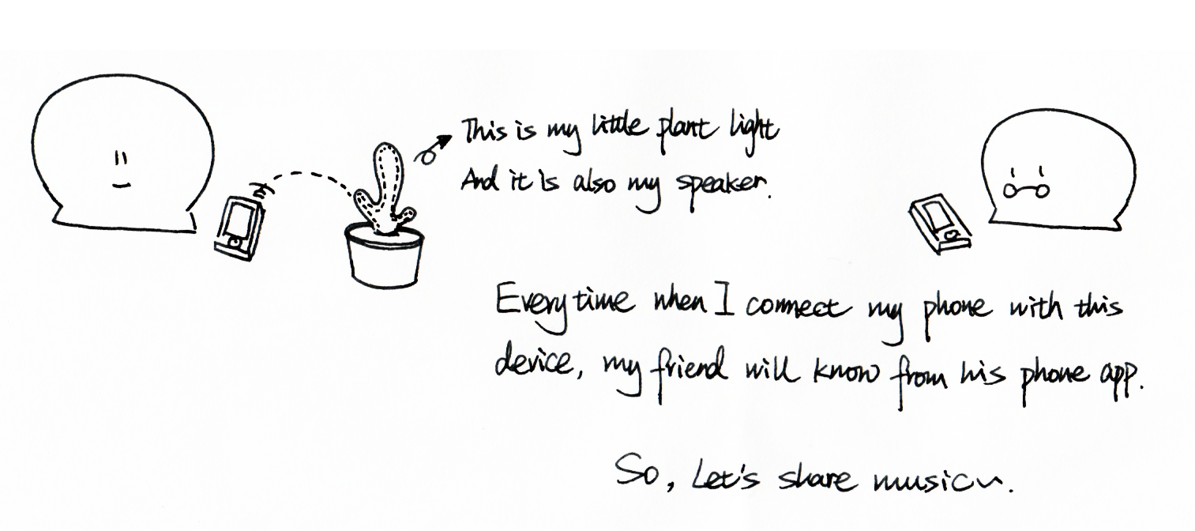
Storyboard

Slide 5
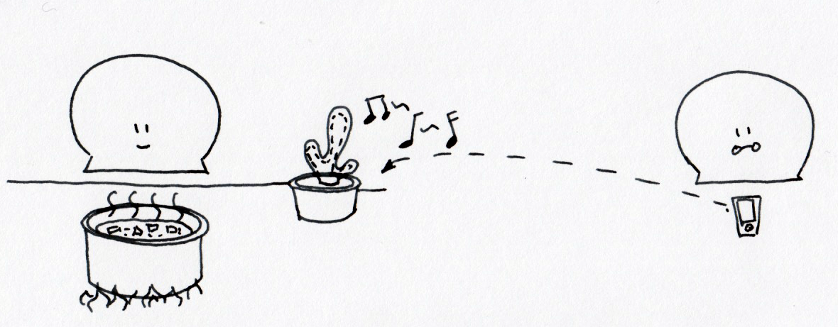
Storyboard
My friend often play music through my little plant light when I cook.

Slide 6
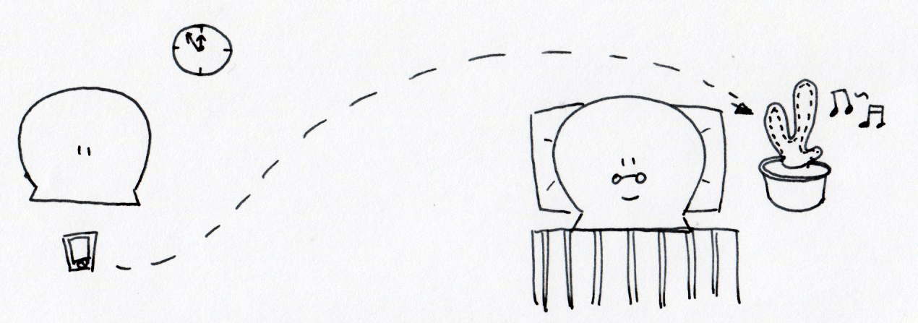
Storyboard
I also transfer light music to my friend’s light for remind to sleep

Slide 7

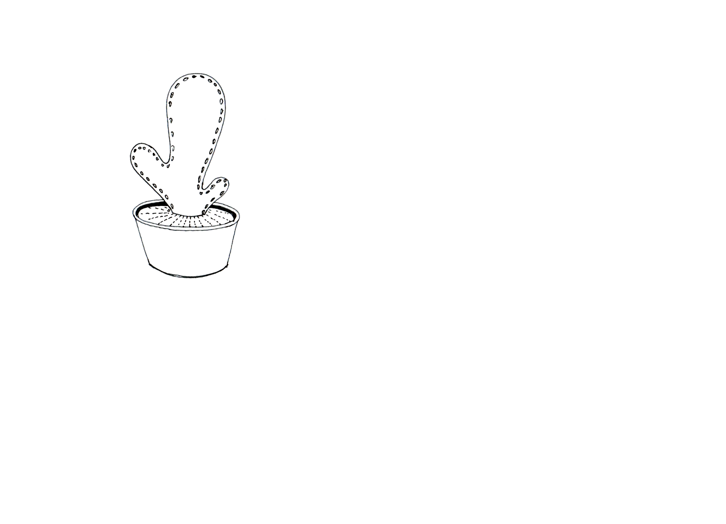


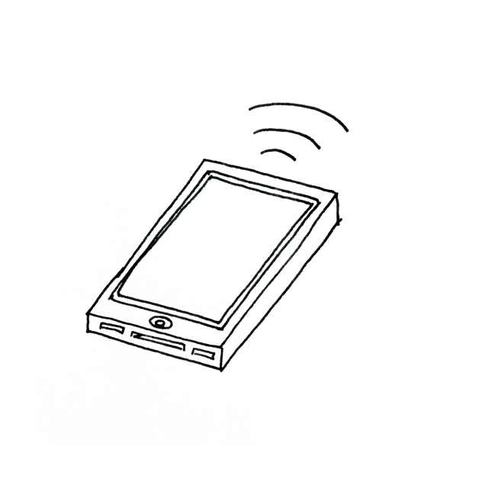
Possible methods
Method 1
Each phone transfers music to the little plant light and this device plays music one by one.

Slide 8
Possible methods
Method 2
My friend share music from his phone to my phone by APP and my phone connect with the
little plant light and play these music.

